Slide 1


SIMATS ENGINEERING
Saveetha Institute of Medical and Technical Sciences
Chennai-602105.
Technical Presentation
CSA0314 - DATA STRUCTURES
Guided by:
Dr. Krishnaraj Mony
Presented By :
Ch. Sriram(192511011)
Supervised by: DR .S. Magesh kumar
1

Slide 2
Problem & Requirement
Problem:
A navigation system connects different cities and locations.
Each city may have connections with many other cities.
Roads have different distances or travel times.
The system needs to find the shortest route between two locations.
Requirements:
Store cities.
Store road connections.
Store distance/time.
Find the shortest route.
3

Slide 3
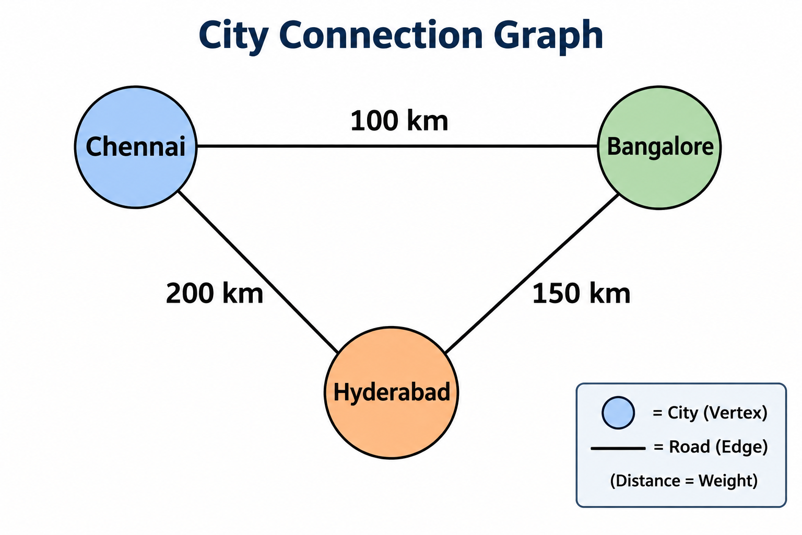
Suitable Data Structure: Graph
A Graph is a non-linear data structure containing:
Vertices (Nodes) → Cities/locations
Edges → Roads/connections
Weights → Distance or travel time
Weighted Graph is suitable because every road can have a different distance.

Slide 4
Shortest Path Using Dijkstra's Algorithm
Dijkstra's Algorithm can find the shortest route when road weights are non-negative.
Steps:
Select the starting city.
Set its distance as 0.
Set other distances as infinity.
Select the city with the smallest distance.
Update distances of connected cities.
Repeat until the destination is reached.
Example:
A → B = 4 km
B → D = 2 km
Shortest route:
A → B → D = 6 km

Slide 5
Why Graph is Appropriate?
Data Structure | Suitability
Array | Less suitable
Linked List | Less suitable
Stack | Not suitable
Queue | Not suitable
Tree | Limited
Graph | Highly suitable

Slide 6
Advantages of Graph
Represents city-to-city connections easily.
Supports multiple connections between locations.
Stores distance or travel time as edge weights.
Helps find the shortest route efficiently.
Can represent one-way and two-way roads.
Suitable for large navigation and road networks.
Easy to update when new roads or cities are added.

Slide 7
Conclusion
A weighted graph is suitable for a navigation system.
Cities are represented as vertices.
Roads are represented as edges.
Distance or travel time is represented as weights.
Dijkstra's algorithm can find the shortest route.
Graphs are widely useful for GPS, maps, transport and route-planning systems.

Slide 8


